Slide 1
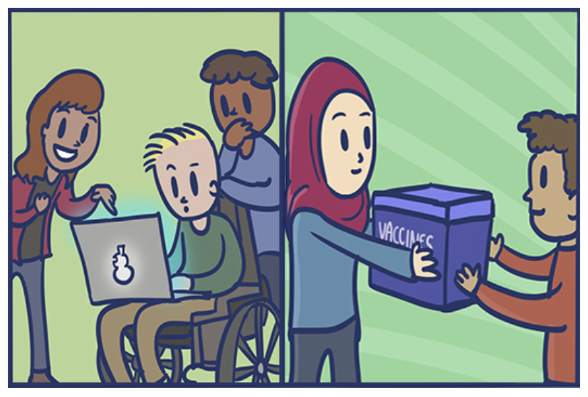
CONNECT YOUR CURRICULUM TO GLOBAL CITIZENSHIP

Slide 2
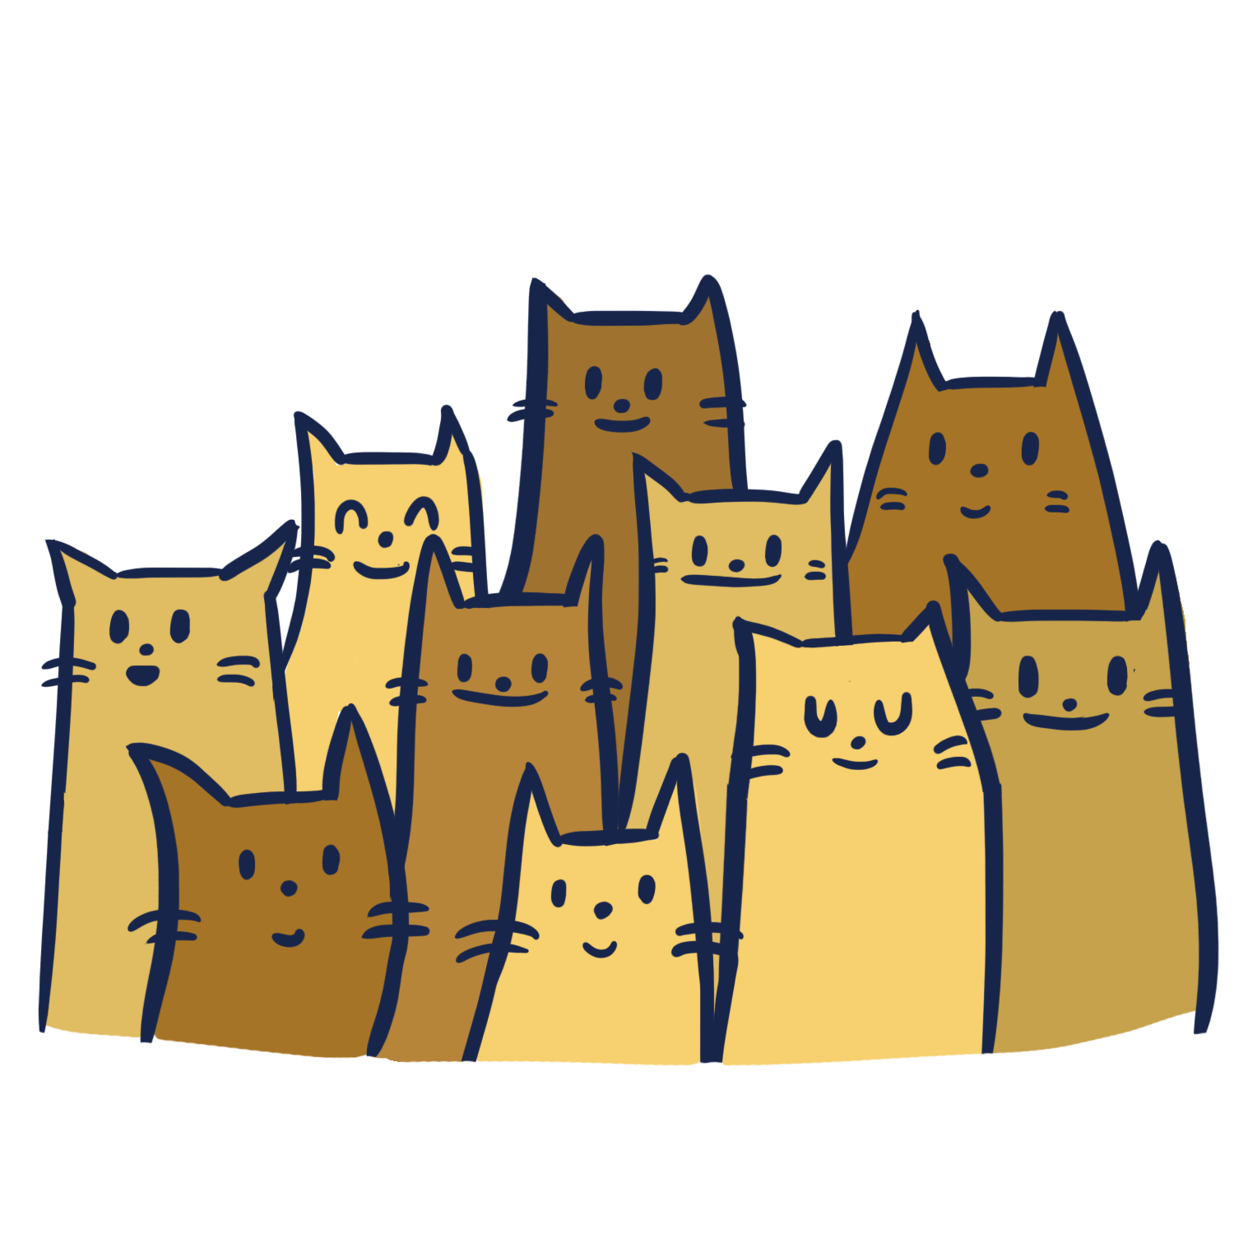
WHAT IS KIDS BOOST IMMUNITY?
FREE Online Lessons created by TEACHERS
Lessons are teacher led or self directed learning
Designed to meet curriculum outcomes in science, social studies & health
Kids Boost Immunity (KBI) donates vaccines to children in other parts of the world through UNICEF Canada when students successfully complete quizzes

Slide 3
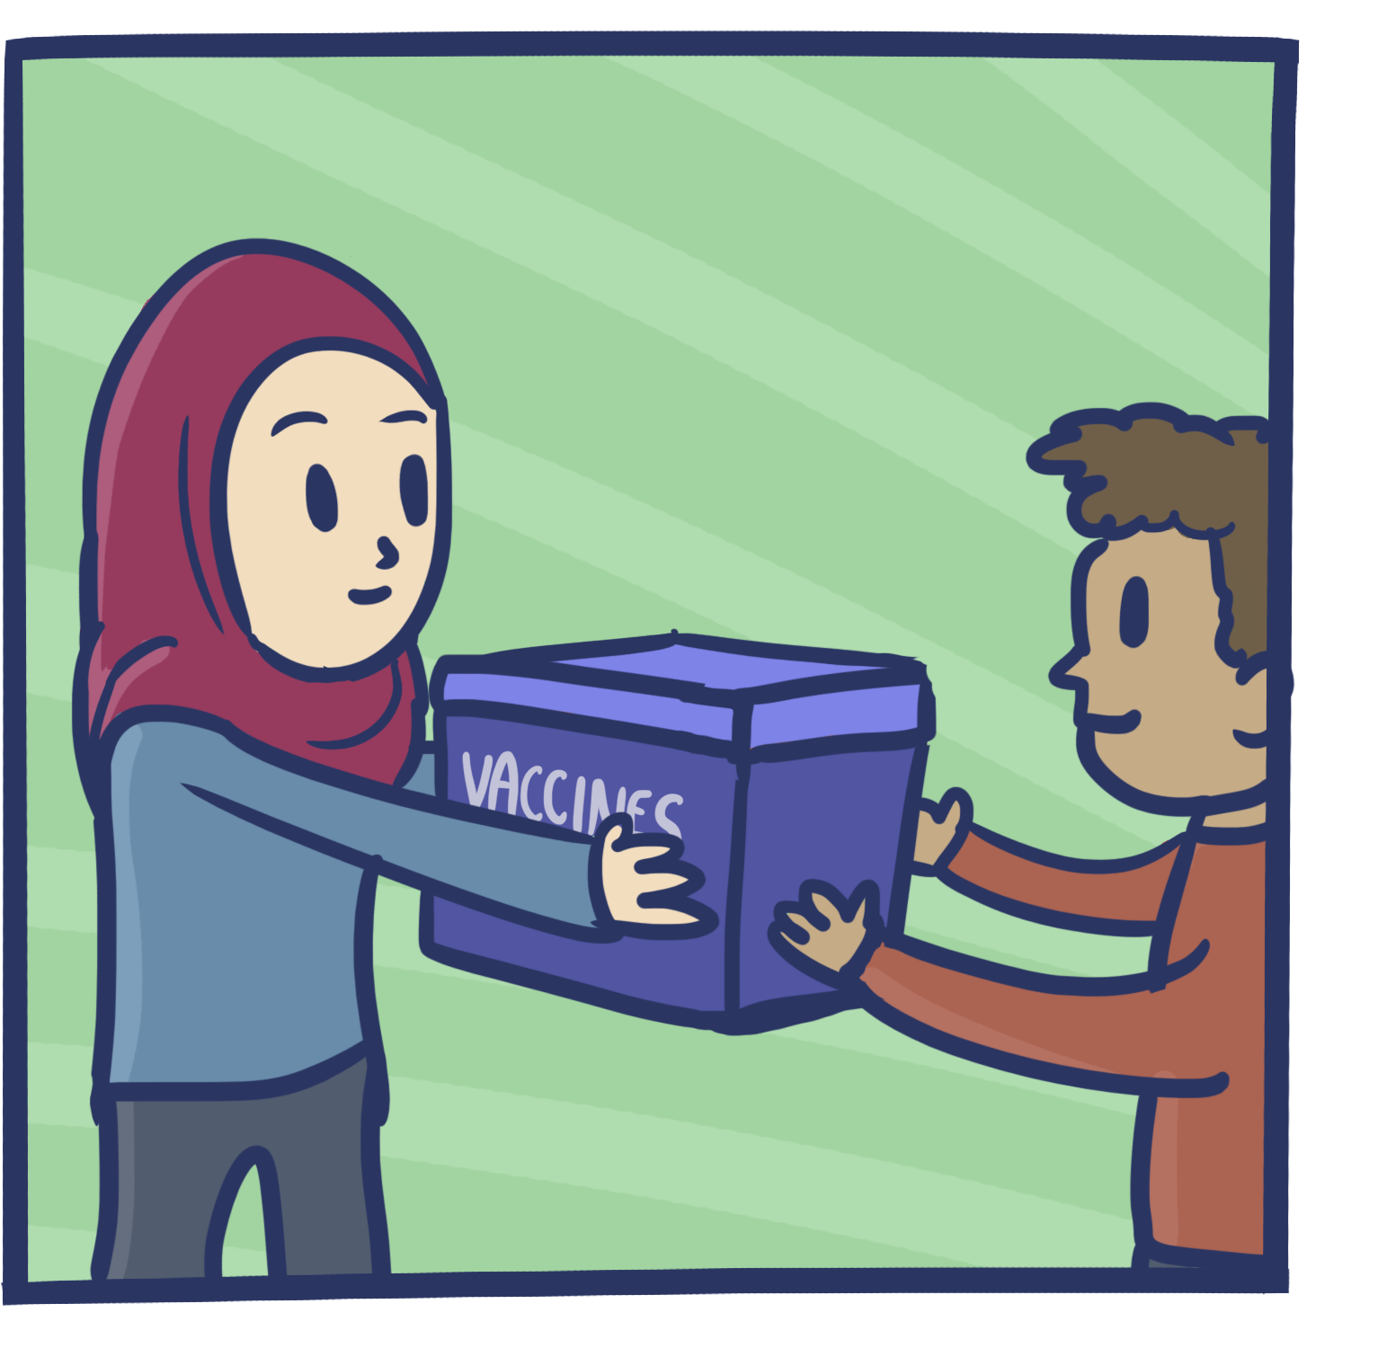
KBI PROMOTES GLOBAL CITIZENSHIP
Digital-age students engage in online quizzes to earn vaccines
KBI purchases vaccines that are donated through UNICEF Canada
Local learning inspires global citizenship as students help to donate vaccines to children in other parts of the world

Slide 4
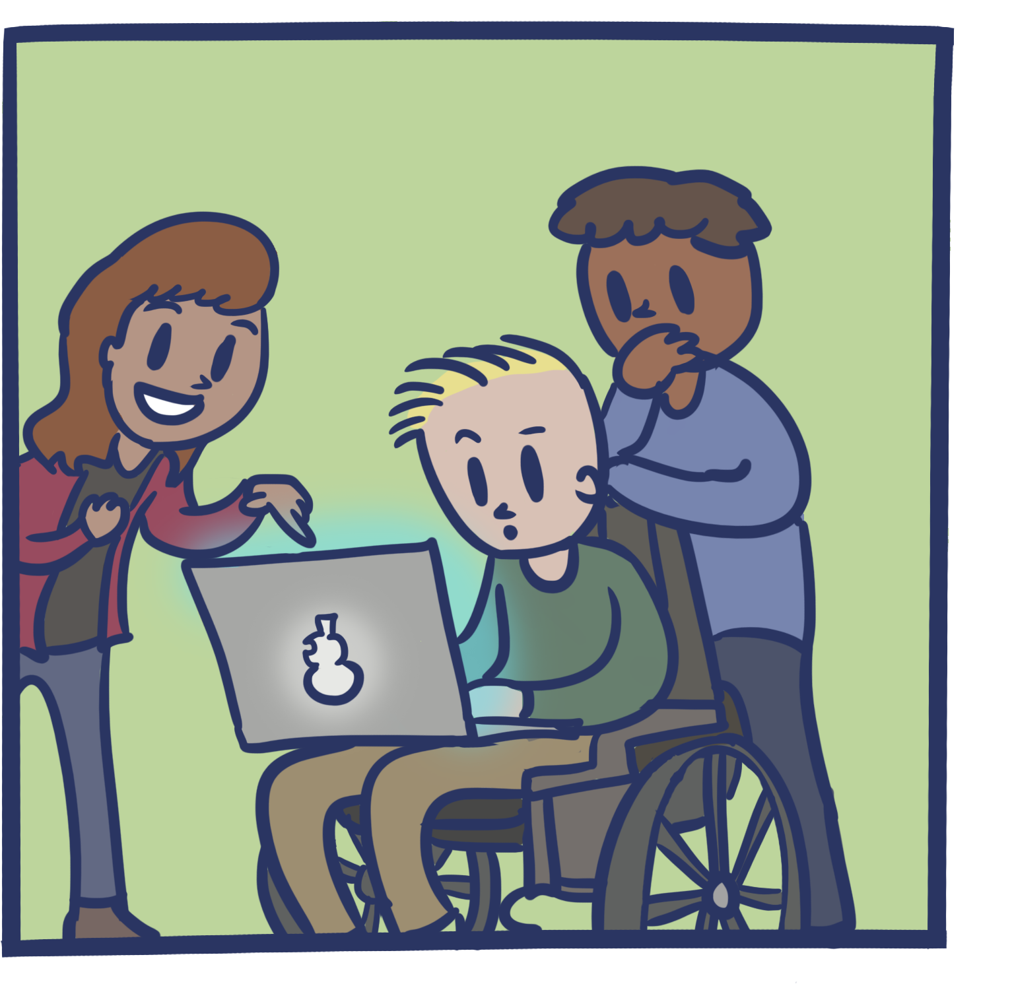
WHY DO STUDENTS LIKE KBI ?
Engaging quiz based format, fun interactive lessons
KBI meets a broad range of learning needs
Students can use a computer, tablet, or phone
Students are inspired as global citizens to earn vaccines for children in other parts of the world

Slide 5
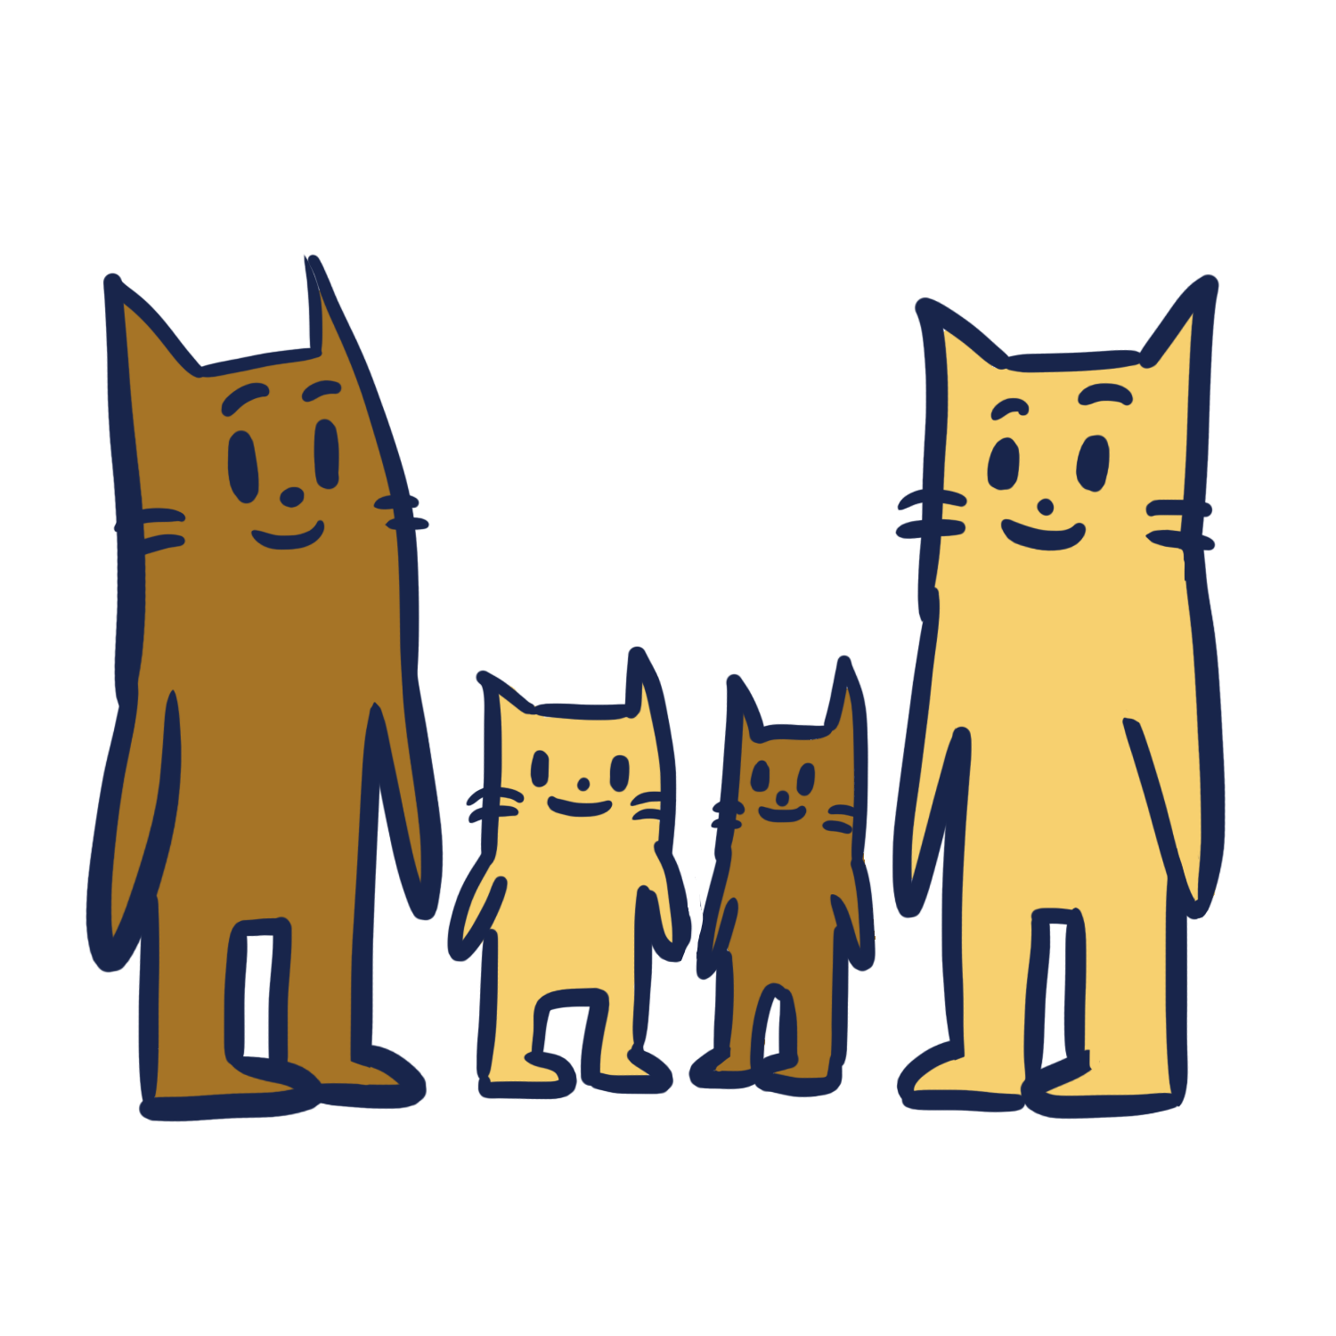
WHY DO TEACHERS LIKE KBI?
Provides 70+ current & accurate lessons
Engages digital students in inquiry
Supports literacy/meets broad learning needs
Meets learning outcomes
Fosters awareness of global health issues
Uses a game format for friendly competition

Slide 6
CURRICULUM FIT
KBI is tailored for grades 4-12, but there are specific grades that are particularly a great fit within each provincial/territorial curriculum
To find out how KBI fits with your province/territory's learning outcomes, go online to:
https://kidsboostimmunity.com/how-it-works

Slide 7
CHECK OUT EXAMPLE LESSONS
Many lessons are available for teachers to view under ‘How it Works’ in the menu bar
https://kidsboostimmunity.com/example-lessons

Slide 8
WHAT ARE TEACHERS SAYING?
"My students and I enjoyed using Kids Boost Immunity because it's both science and health at the same time. There is a real world connection with public health campaigns or advocacy and science learning outcomes…Thanks KBI!“
-Gigi, Grade 6-9 Science, Health, Education & Technology Teacher
"It was fun earning vaccines with the class, and it helped the students learn the curriculum. It also resulted in good discussions about health care in developing countries." -Geoff, Grade 8 Science Teacher
https://kidsboostimmunity.com/testimonials

Slide 9
WHAT ARE STUDENTS SAYING?
KBI Survey Results:
I want to help others
I like doing online quizzes
I like competing against my friends and classmates (e.g. ‘gamification’)
I like learning about vaccination

Slide 10
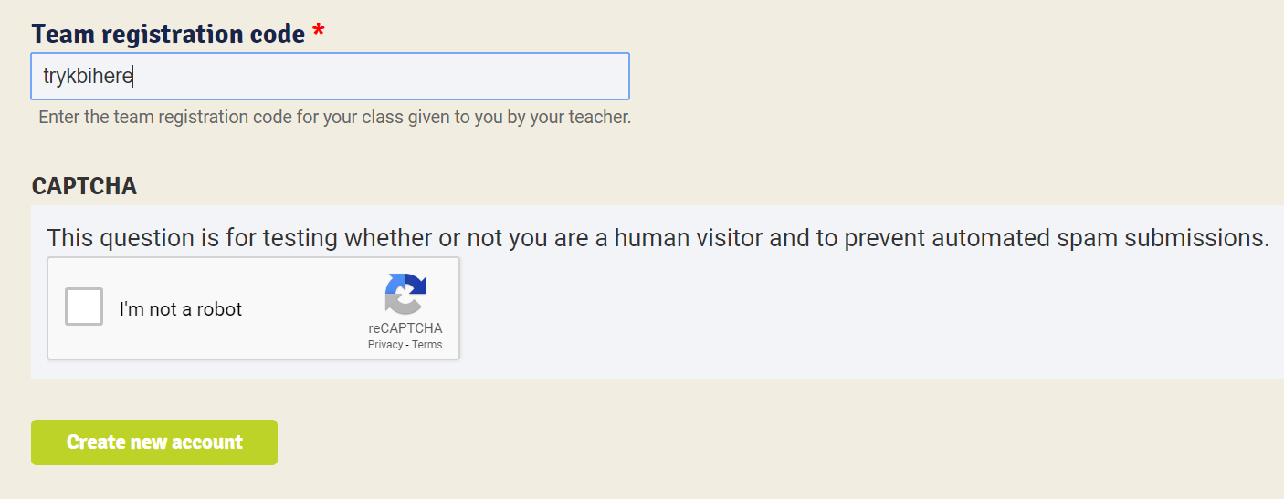
TRY KBI AS A STUDENT!
Join our Demonstration Class today:
www.kidsboostimmunity.com/user/register
Team Registration code: trykbihere

Slide 11
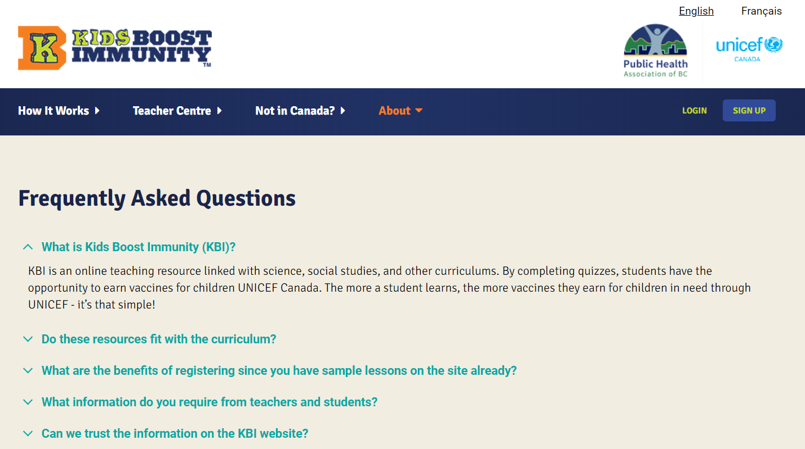
FREQUENTLY ASKED QUESTIONS
https://kidsboostimmunity.com/frequently-asked-questions

Slide 12
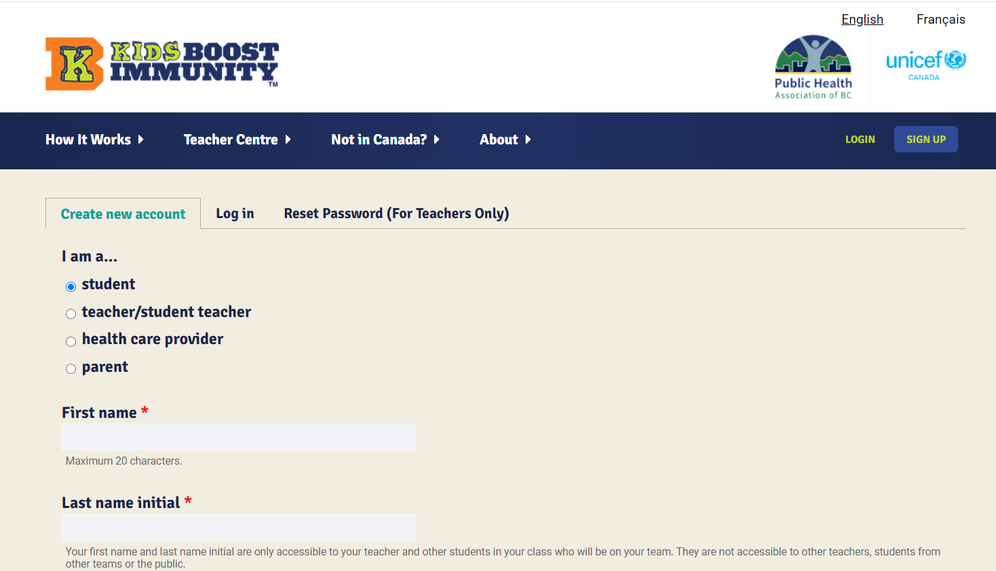
REGISTER TODAY-IT’S SIMPLE!
https://kidsboostimmunity.com/user/register

Slide 13
QUESTIONS? Email: info@kidsboostimmunity.com

